Slide 1

MET 256: WEATHER FORECASTING AND OBSERVATIONS
Jeffrey N. A. Aryee (PhD)
Meteorology & Climate Science Programme
Department of Physics, KNUST, Ghana
e-mail: jeff.jay8845@gmail.com
https://github.com/jeffjay88/MET256_WEATHER_FORECASTING_AND_OBSERVATIONS_LECTURE_SERIES

Slide 2
LECTURE 2

Slide 3

General requirements of Meteorological Instruments
The most important requirements for meteorological instruments are the following:
(a) Uncertainty, according to the stated requirement for the particular variable;
(b) Reliability and stability;
(c) Convenience of operation, calibration and maintenance;
(d) Simplicity of design which is consistent with requirements;
(e) Durability;
(f) Acceptable cost of instrument, consumables and spare parts.

Slide 4
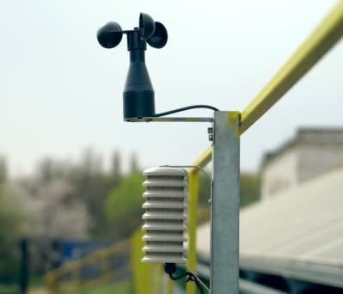
General requirements of Meteorological Instruments
With regards to the first two requirements, it is important that an instrument maintains a known uncertainty over a long period. This is much better than having a high initial uncertainty that cannot be retained for long under operating conditions.
Initial calibrations of instruments will, in general, reveal departures from the ideal output, necessitating corrections to observed data during normal operations. It is important that the corrections should be retained with the instruments at the observing site and that clear guidance be given to observers for their use.

Slide 5
(a) Outdoor instruments should be installed on a level piece of ground, preferably no smaller than 25 m x 25 m where there are many installations, but in cases where there are relatively few installations (as in Figure on left) the area may be considerably smaller, eg., 10 m x 7 m (the enclosure). The ground should be covered with short grass or a surface representative of the locality, and surrounded by open to exclude unauthorized persons.
Layout of an observing station in the northern hemisphere showing minimum distances between installations

Slide 6
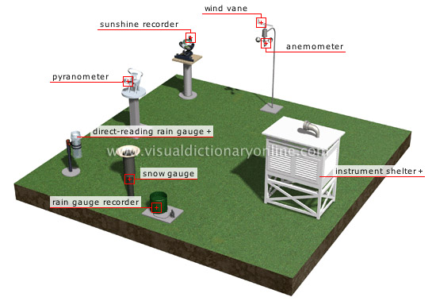
(b) There should be no steeply sloping ground in the vicinity, and the site should not be in a hollow. If these conditions are not met, the observations may show peculiarities of entirely local significance;
(c) The site should be well away from trees, buildings, walls or other obstructions. The distance of any such obstacle (including fencing) from the rain gauge should not be less than twice the height of the object above the rim of the gauge, and preferably four times the height.

Slide 7
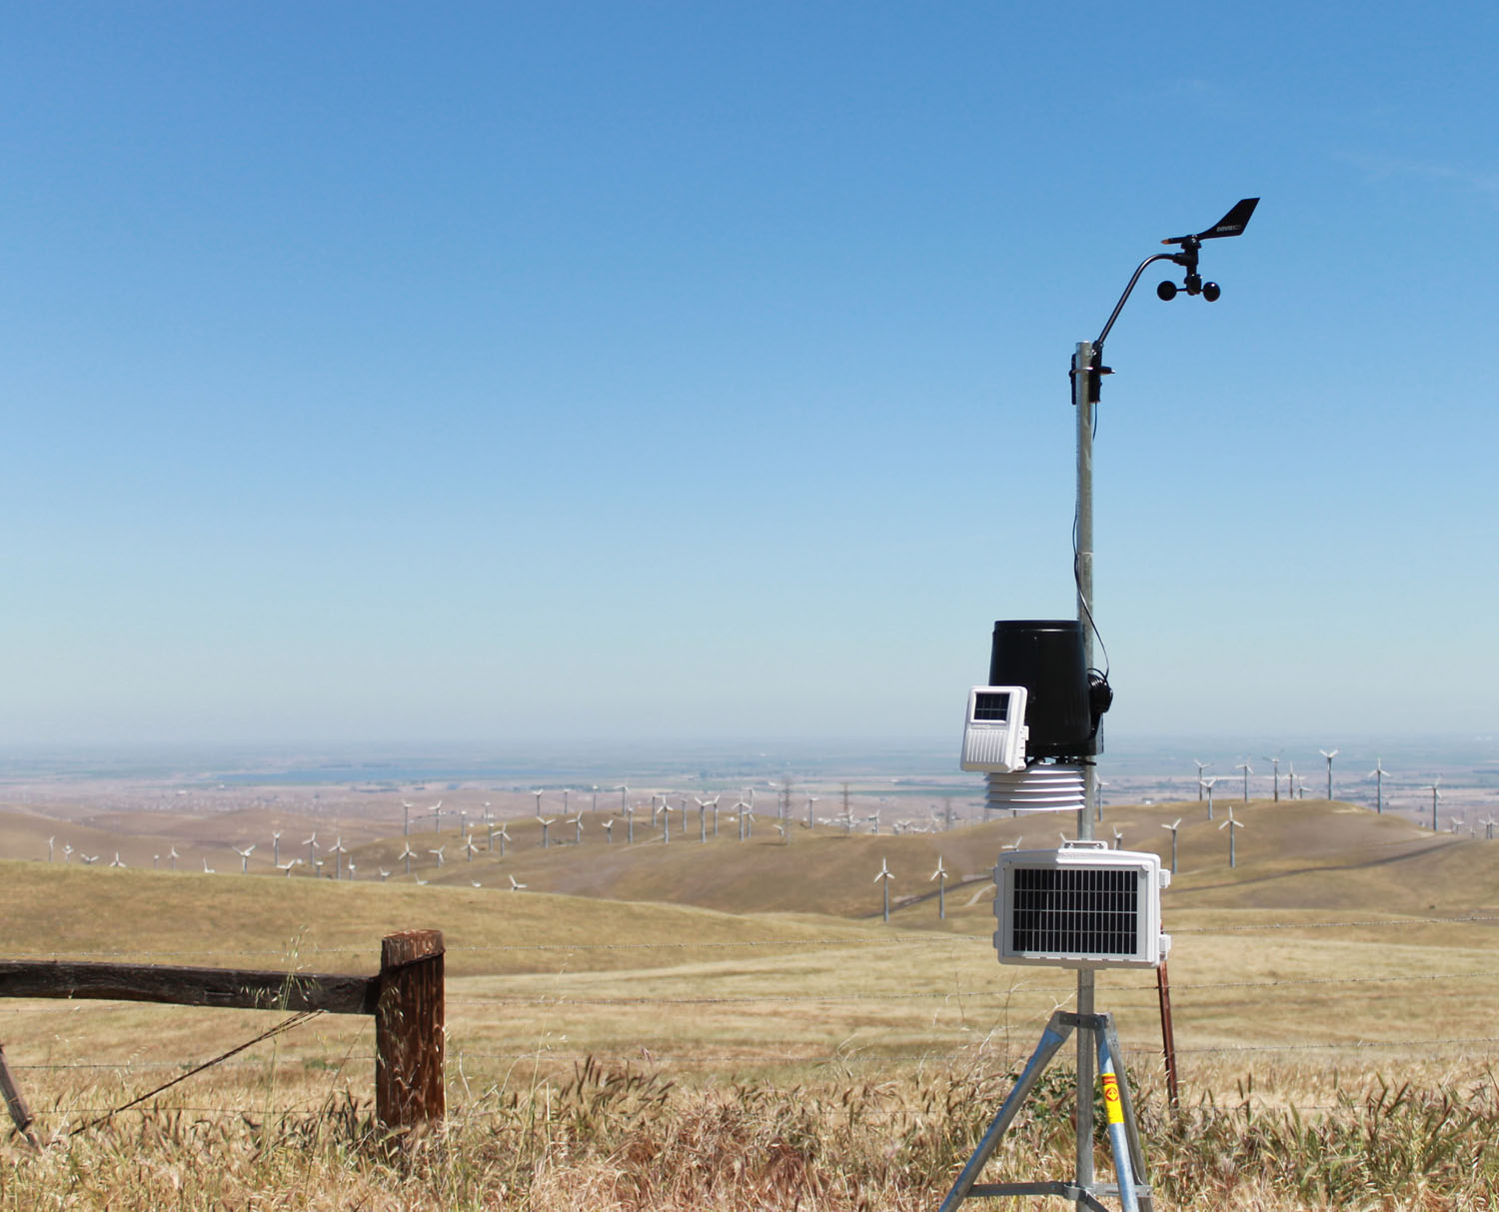
(d) Very open sites which are satisfactory for most instruments are unsuitable for rain gauges. For such sites, the rainfall catch is reduced in conditions other than light winds and some degree of shelter is needed;
(e) If in the instrument enclosure surroundings, maybe at some distance, objects like trees or buildings obstruct the horizon significantly, alternative viewpoints should be selected for observations of sunshine or radiation;

Slide 8
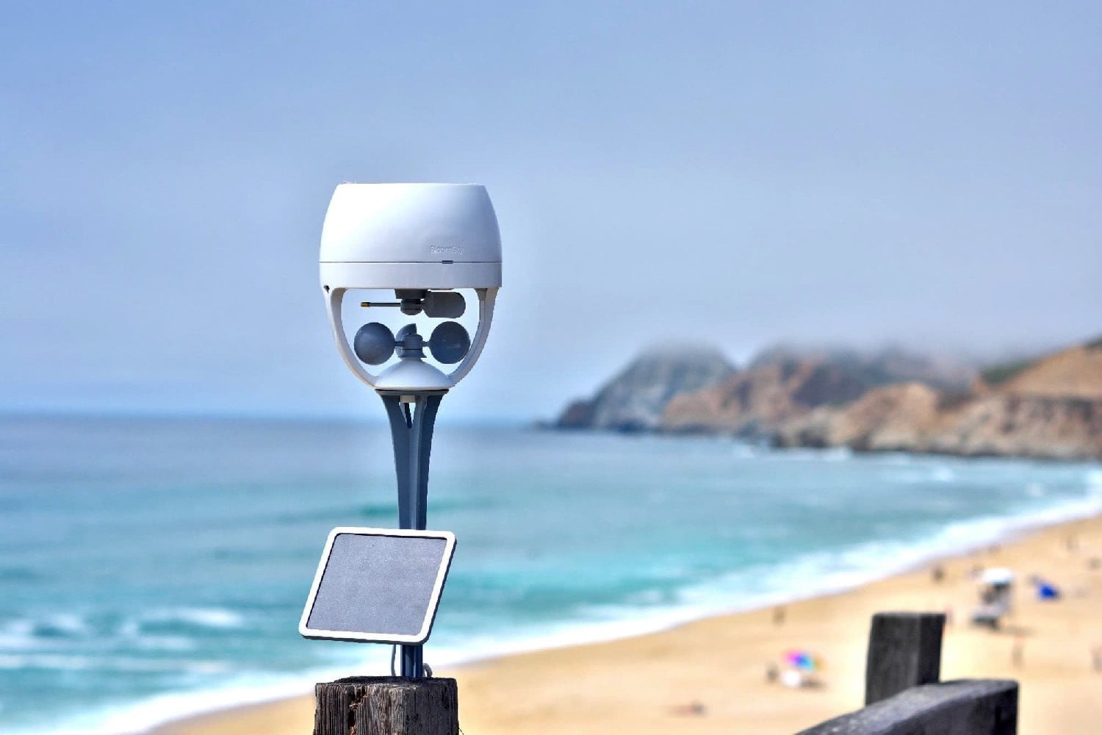
(f) The position used for observing cloud and visibility should be as open as possible and command the widest possible view of the sky and the surrounding country;
(g) At coastal stations, it is desirable that the station command a view of the open sea. However, the station should not be too near the edge of a cliff because the wind eddies created by the cliff will affect the wind and precipitation measurements;
(h) Night observations of cloud and visibility are best made from a site unaffected by extraneous lighting.

Slide 9

Class Discussion
Class to identify some surface observation elements, their measuring instruments and measurement approach.

Slide 10
Surface Observations
The following elements are observed at stations making surface observations
Present weather Past weather
Wind direction and speed Cloud amount
Cloud type Cloud-base height
Visibility Temperature
Relative humidity Atmospheric pressure
Precipitation Snow cover
Sunshine and/or solar radiation Soil temperature
Evaporation
Instruments exist which can measure all of these elements, except cloud type. However, with current technology, instruments for present and past weather, cloud amount and height, and snow cover are not able to make observations of the whole range of phenomena, whereas human observers are able to do so.

Slide 11
Class Discussion
Why the need for Automatic Weather Stations?
In the advent of AWS, are observers still needed in meteorological observations?

Slide 12
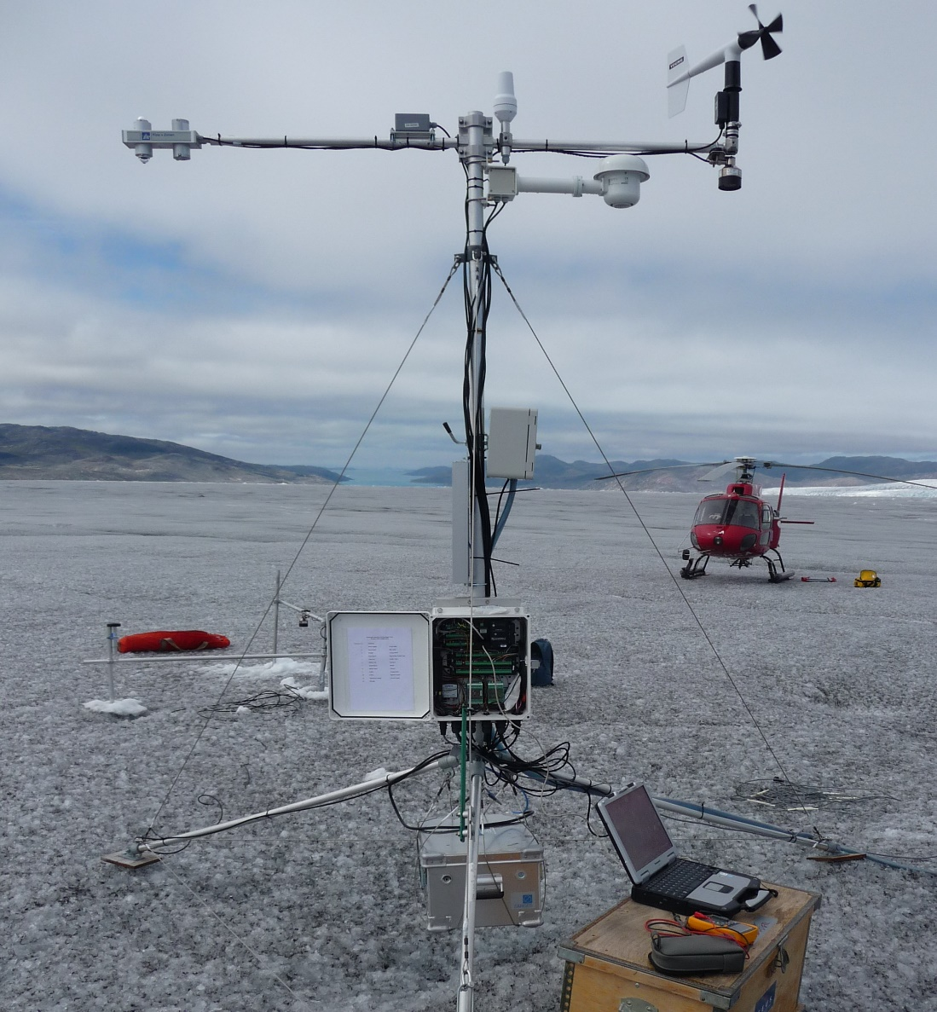
Automatic Weather Stations
As the capabilities of automatic systems increase, the ratio of purely automatic weather stations to observer-staffed weather stations (with or without automatic instrumentation) increases steadily. The guidance regarding siting and exposure, changes of instrumentation, and inspection and maintenance apply equally to automatic weather stations and staffed weather stations.

Slide 13
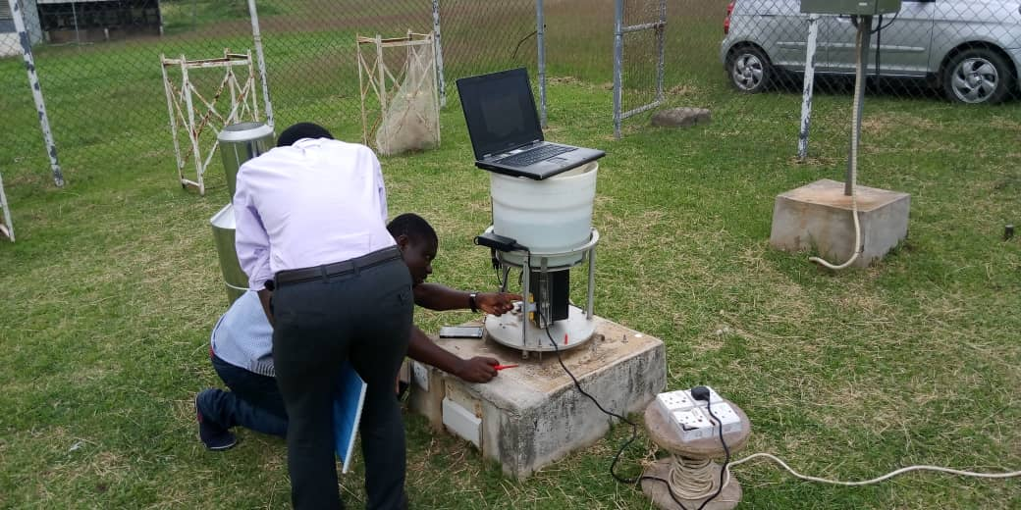
Meteorological observers are required for numerous reasons
(a) To make synoptic and/or climatological observations to the required uncertainty and representativeness with the aid of appropriate instruments;
(b) To maintain instruments, metadata documentation and observing sites in good order
(c) To code and dispatch observations (in the absence of automatic coding and communication systems);
(d) To maintain in situ recording devices, including the changing of charts when provided;

Slide 14
Meteorological observers are required for numerous reasons
(e) To make or collate weekly and/or monthly records of climatological data where automatic systems are unavailable or inadequate;
(f) To provide supplementary or back-up observations when automatic equipment does not make observations of all required elements, or when it is out of service;
(g) To respond to public and professional enquiries.

Slide 15
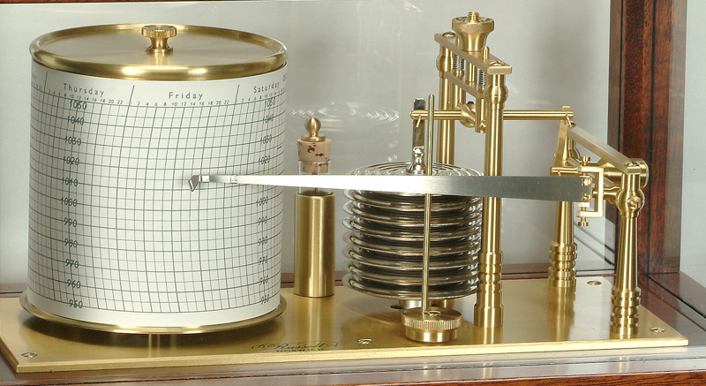
Recording instruments used in meteorology
motion of the sensing element is magnified by levers that move a pen on a chart on a clock-driven drum. Such recorders should be as free as possible from friction, not only in the bearings, but also between the pen and paper.
Some means of adjusting the pressure of the pen on the paper should be provided, but this pressure should be reduced to a minimum consistent with a continuous legible trace.

Slide 16
Recording instruments used in meteorology
Means should also be provided in clock-driven recorders for making time marks. In the design of recording instruments that will be used in cold climates, particular care must be taken to ensure that their performance is not adversely affected by extreme cold and moisture, and that routine procedures (time marks, and so forth) can be carried out by the observers while wearing gloves.
Recording instruments should be compared frequently with instruments of the direct-reading type.

Slide 17
Ghana Meteorological Agency’s manned stations and the elements measured
SYNOPTIC (22) | AGROMET (50) | CLIMO (54) | RAINFALL (81)
1. Air temperature 2. Dew point temp. 3.Windspeed & direction 4. Humidity 5.Atmospheric pressure 6. Visibility 7. Cloud type, amount & height of cloud base 8. Amount of Precipitation 9.Present and Past Weather 10.24 hour pressure difference 11. Extreme temperature 12. Sunshine duration & intensity 13.Evaporation 14. Soil temperatures 15. Rainfall intensity | 1. Air temperature 2. Dew point temperature 3. Wind-speed & direction 4. Amount of Precipitation 5. Sunshine 6. Evaporation 7. Soil Temperature 8.Extreme temperatures 9. Rainfall intensity 10. Humidity | Air temperature Dew point temp. Humidity Wind-speed & direction Amount of precipitation Evaporation Extreme temperatures | Amount of precipitation

Slide 18
For meteorological purposes, temperatures are measured for a number of media.
The most common variable measured is air temperature (at various heights).
Other variables are ground, soil, grass minimum and seawater temperature. WMO (1992) defines air temperature as “the temperature indicated by a thermometer exposed to the air in a place sheltered from direct solar radiation”. The thermodynamic temperature (T), with units of kelvin (K),), is the basic temperature. In the thermodynamic scale of temperature, measurements are expressed as differences from absolute zero (0 K), the temperature at which the molecules of any substance possess no kinetic energy.
The temperature (T), in degrees Celsius (or “Celsius temperature”) defined by the equation below, is used for most meteorological purposes
T/°C = T/K – 273.15

Slide 19
QUICK TRIAL
Write a simple FORTRAN script that reads Temperature values (in degrees Celsius) from the file ‘Air-Temperature.csv’, and convert them into Kelvin temperature values. Save the output data into the file Your_Index_Number-Air-Temperature-Assignment.csv. Also save the script as Your_Index_Number-Air-Temperature-Assignment.f

Slide 20
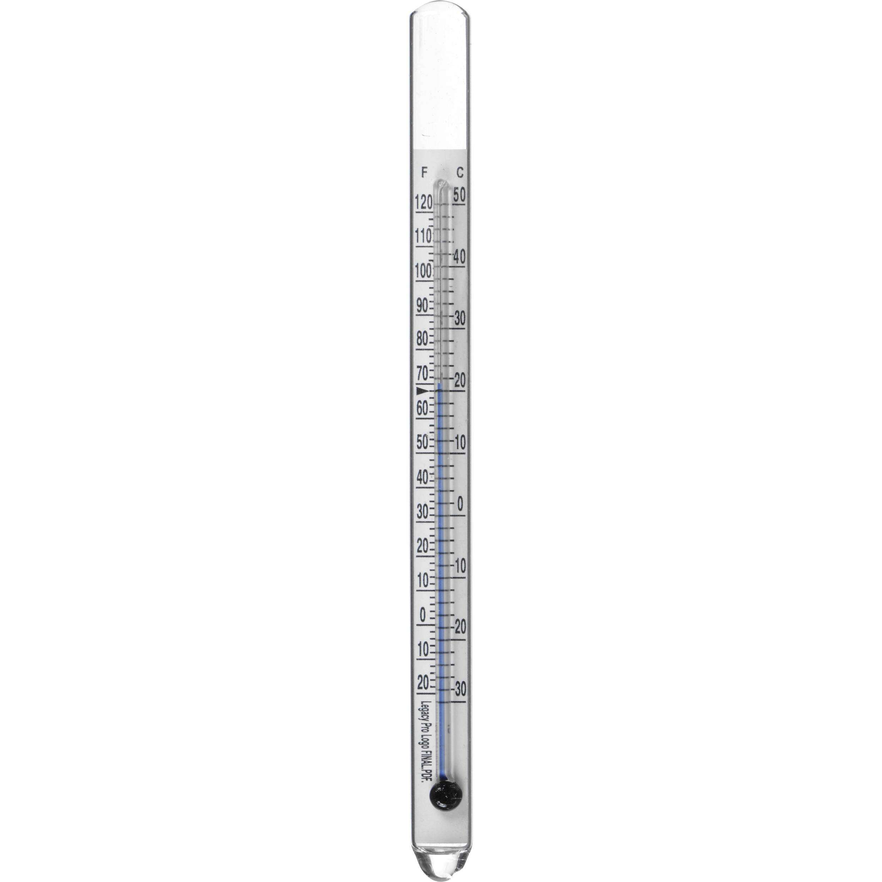
Meteorological requirements for temperature measurements primarily relate to:
(a) The air near the Earth’s surface;
(b) The surface of the ground;
(c) The soil at various depths;
(d) The surface levels of the sea and lakes;
(e) The upper air.
These measurements are required, either jointly or independently and locally or globally for
input to numerical weather prediction models,
hydrological and agricultural purposes, and as
indicators of climatic variability.

Slide 21
Local temperature also has direct physiological significance for the
day-to-day activities of the world’s population.
Measurements of temperature may be required as continuous records or may be sampled at different time intervals.

Slide 22
Recording the circumstances in which measurements are taken
Temperature is one of the meteorological quantities whose measurements are particularly sensitive to exposure.
For climate studies in particular, temperature measurements are affected by the state of the surroundings, by vegetation, by the presence of buildings and other objects, by ground cover, by the condition of, and changes in, the design of the radiation shield or screen, and by other changes in equipment.
It is important that records should be kept not only of the temperature data, but also of the circumstances in which the measurements are taken. Such information is known as metadata (data about data).

Slide 23
Thermometers which indicate the prevailing temperature are often known as ordinary thermometers, while those which indicate extreme temperature over a period of time are called maximum or minimum thermometers.
Ordinary thermometers
Thermometers should be read as rapidly as possible in order to avoid changes of temperature caused by the observer’s presence. Since the liquid meniscus, or index, and the thermometer scale are not on the same plane, care must be taken to
avoid parallax errors.

Slide 24
Maximum / Minimum Thermometers
Day maximum and night minimum temperatures are measured using maximum
and minimum thermometers respectively.
Maximum and minimum thermometers should be read and set at least twice daily. Their readings should be compared frequently with those of an ordinary thermometer in order to ensure that no serious errors develop.
The recommended type for maximum thermometers is a mercury-in-glass thermometer with a constriction in the bore between the bulb and the beginning of the scale. This constriction prevents the mercury column from receding with falling temperatures. However, observers can reset by holding it firmly, bulb-end downwards, and swinging their arm until the mercury column is reunited.

Slide 25
A maximum thermometer should be mounted at an angle of about 2° from the horizontal position, with the bulb at the lower end to ensure that the mercury column rests against the constriction without gravity forcing it to pass.
As regards minimum thermometers, the most common instrument is a spirit thermometer with a dark glass index, about 2 cm long, immersed in the spirit. Since some air is left in the tube of a spirit thermometer, a safety chamber should be provided at the upper end which should be large enough to allow the instrument to withstand a temperature of 50°C without being damaged.
Minimum thermometers should be supported in a similar manner as maximum thermometers, in a near-horizontal position. Various liquids can be used in minimum thermometers, such as ethyl alcohol and pentane.

Slide 26
Thermometer siting and exposure
Both ordinary thermometers and maximum and minimum thermometers are always exposed in a thermometer screen placed on a support. Most of the numerous varieties of louvred screen rely on natural ventilation. The walls of such a screen should preferably be double-louvred and the floor should be made of staggered boards, but other types of construction may be found to meet the above requirements. The roof should be double layered, with provisions for ventilation of the two layers.
The size and construction of the screen should be such that it keeps the heat capacity as low as practicable and allows ample space between the instruments and the walls. The latter feature excludes all possibility of direct contact between the thermometer sensing elements and the walls, and is particularly important in the tropics where insolation may heat the sides to the extent that an appreciable temperature gradient is caused in the screen.

Slide 27
Thermometer siting and exposure
Direct contact between the sensing elements and the thermometer mounting should also be avoided. The screen should be painted both inside and outside with white, non-hygroscopic paint.
In general, only one door is needed, with the screen being placed so that the sun does not shine on the thermometers when the door is open at the times of observation. In the tropics, two doors are necessary for use during different periods of the year.

Slide 28
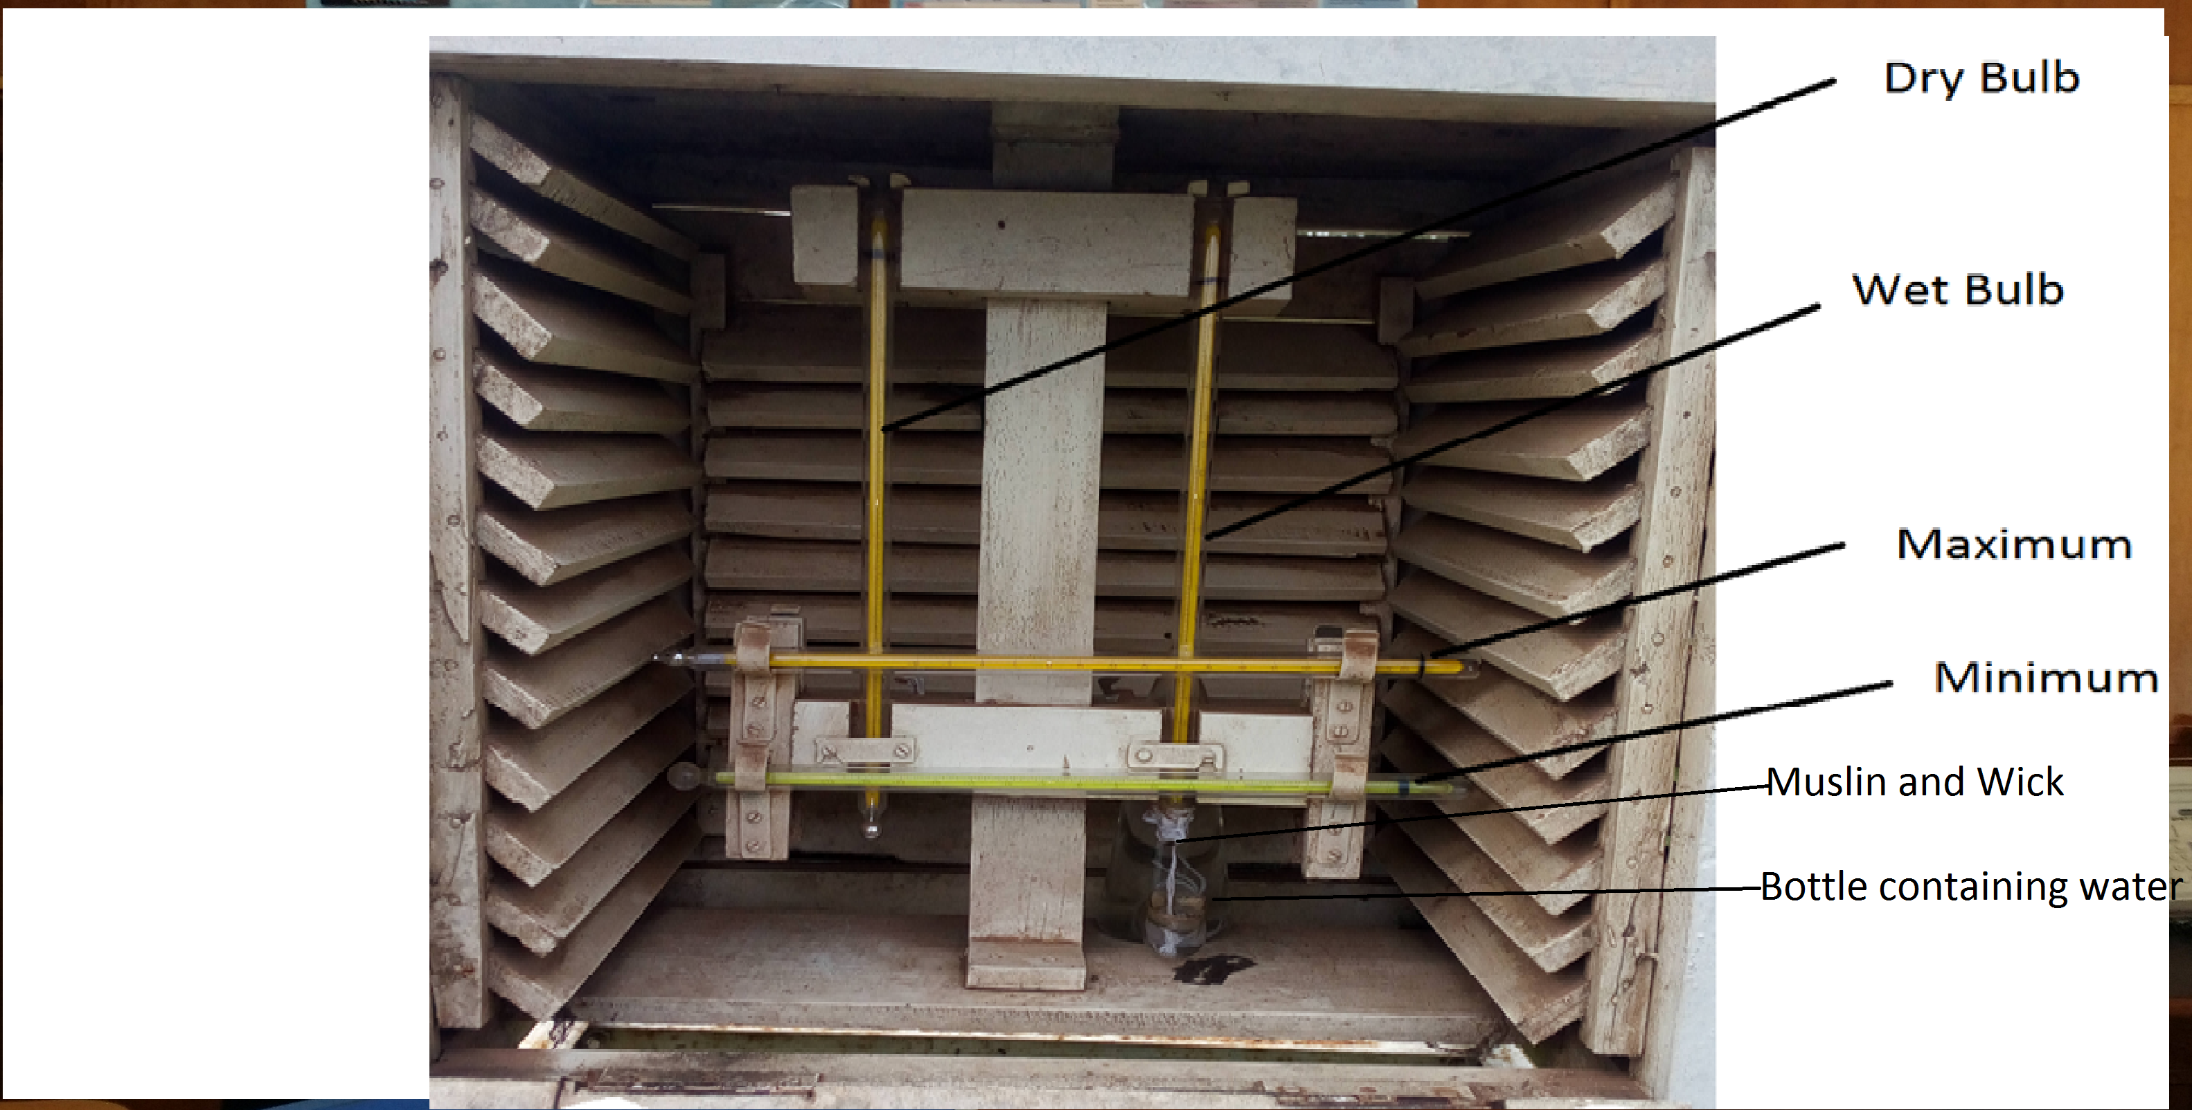
A Stevenson screen
The smallest screens contain a dry bulb thermometer and a wet bulb thermometer. Larger screens also include minimum and maximum thermometers.
Still larger screens can contain recording instruments: a thermograph and/or a hygrograph, or a thermo-hygrograph which combines the functions of those two instruments.

Slide 29
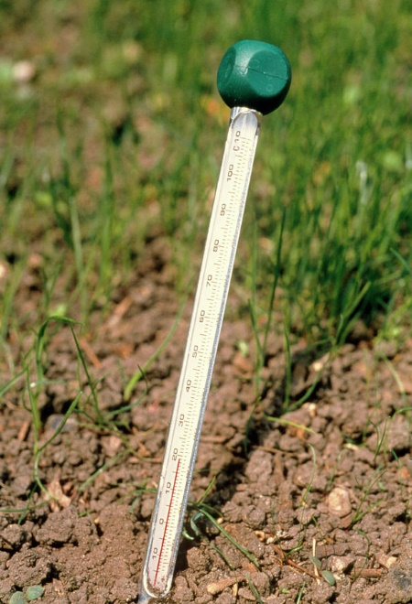
Soil thermometers
The standard depths for soil temperature measurements are 5, 10, 20, 50 and 100 cm below the surface; additional depths may be included. The site for such measurements should be a level plot of bare ground (about 75 cm²) and typical of the surrounding soil for which information is required.
When describing a site for soil temperature measurements, the soil type, soil cover and the degree and direction of the ground’s slope should be recorded.

Slide 30
Measuring grass minimum temperatures
The grass minimum temperature is the lowest temperature reached overnight by a thermometer freely exposed to the sky just above short grass. The temperature is measured with a minimum thermometer.
The thermometer should be mounted on suitable supports so that it is inclined at an angle of about 2° from the horizontal position, with the bulb lower than the stem, 25 to 50 mm above the ground and in contact with the tips of the grass.
Normally, the thermometer is exposed at the last observation hour before sunset, and the reading is taken the next morning. The instrument is kept within a screen or indoors during the day. However, at stations where an observer is not available near sunset, it may be necessary to leave the thermometer exposed throughout the day.

Slide 31


Slide 32
RECAP OF LECTURE
General requirements of Meteorological Instruments
Surface Observations
Automatic Weather Stations
Temperature Observations and Procedures

